Slide 1
An Introduction to Discrete Wavelet Transforms
Advisor : Jian-Jiun Ding, Ph. D.
Presenter : Ke-Jie Liao
NTU,GICE,DISP Lab,MD531

Slide 2
Outlines
Introduction
Continuous Wavelet Transforms
Multiresolution Analysis Backgrounds
  Image Pyramids
  Subband Coding
MRA
Discrete Wavelet Transforms
  The Fast Wavelet Transform
Applications
  Image Compression
  Edge Detection
  Digital Watermarking
Conclusions

Slide 3
Introduction(1)
Why WTs?
  F.T. totally lose time-information.
Comparison between F.T., S.T.F.T., and W.T.
f
f
f
t
t
t
F.T.
S.T.F.T.
W.T.

Slide 4
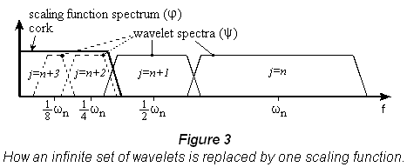
Introduction(2)
Difficulties when CWT DWT?
  Continuous WTs Discrete WTs
  need infinitely scaled wavelets to represent a given function Not possible in real world
  Another function called scaling functions are used to span the low frequency parts (approximation parts)of the given signal.
Sampling
Sampling
F.T.
[5]

Slide 5
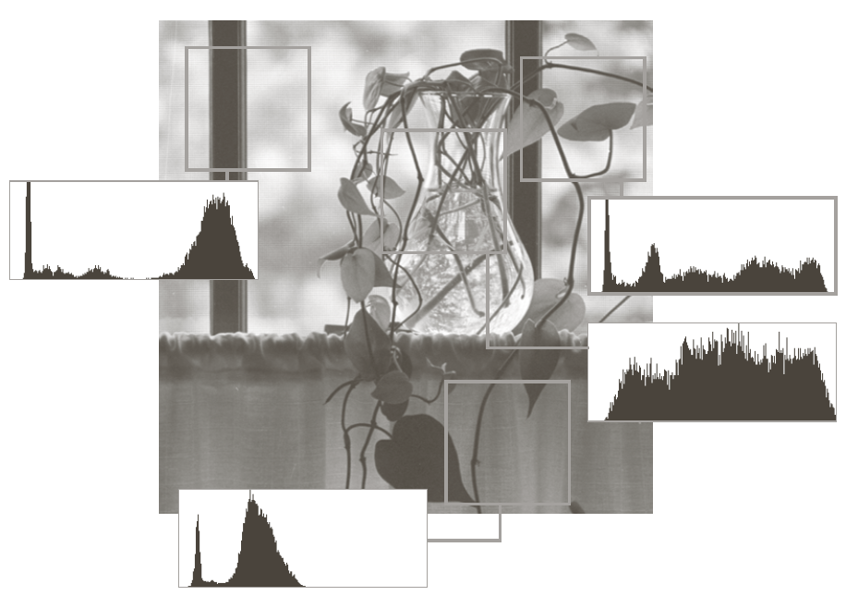
Introduction(3)
MRA
  To mimic human being’s perception characteristic
[1]

Slide 6
CWT
Definitions
  Forward
  where
  Inverse exists only if admissibility criterion is satisfied.

Slide 7
CWT
An example
  -Using Mexican hat wavelet
[1]

Slide 8



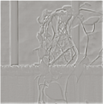

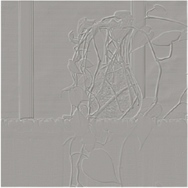
MRA Backgrounds(1)
Image Pyramids
  Approximation pyramids
  Predictive residual pyramids
N/8*N/8
N/4*N/4
N/2*N/2
N*N

Slide 9
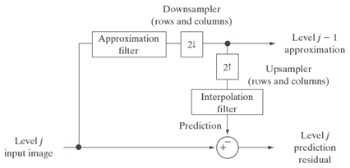
MRA Backgrounds(1)
Image Pyramids
  Implementation
[1]

Slide 10
MRA Backgrounds(2)
Subband coding
  Decomposing into a set of bandlimited components
  Designing the filter coefficients s.t. perfectly reconstruction
[1]

Slide 11
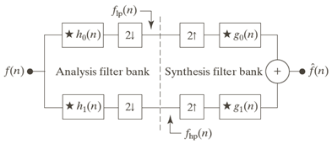
MRA Backgrounds(2)
Subband coding
  Cross-modulated condition
  Biorthogonality condition
or
[1]

Slide 12
MRA Backgrounds(2)
Subband coding
  Orthonormality for perfect reconstruction filter
  Orthonormal filters

Slide 13
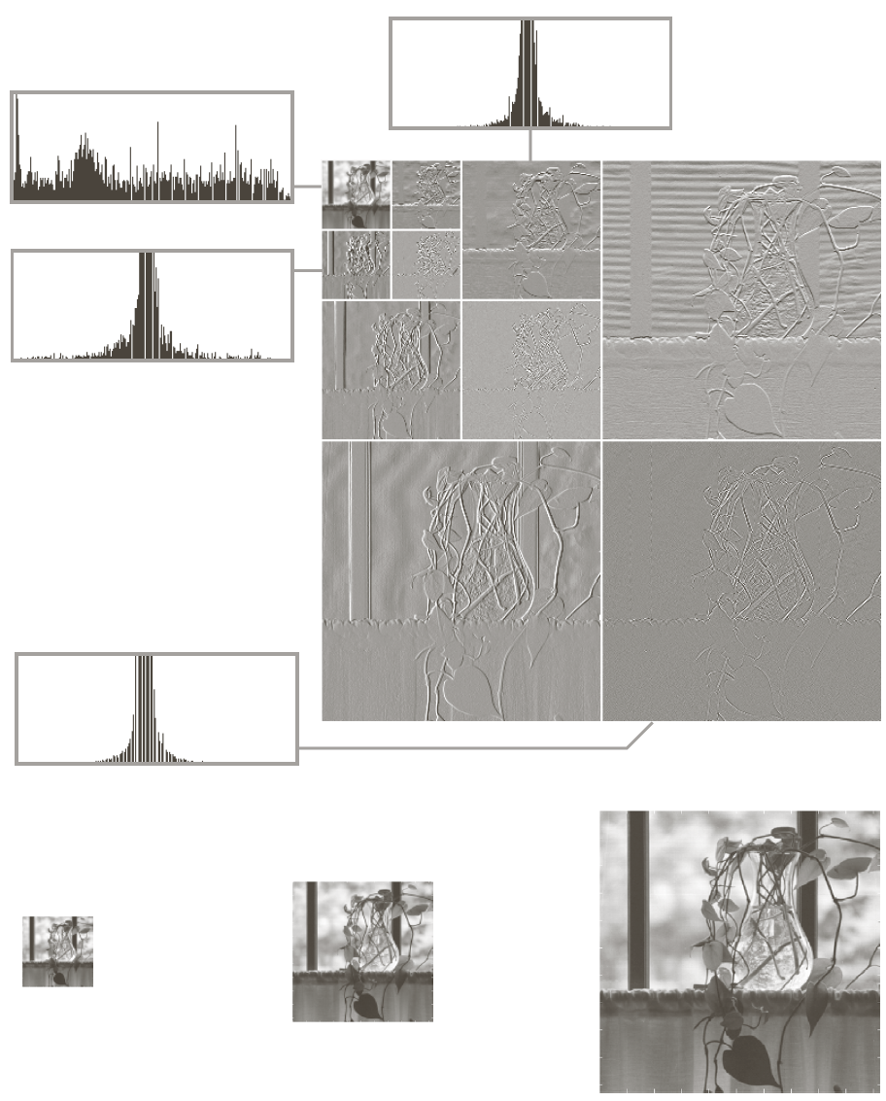
MRA Backgrounds(2)
The Haar Transform
Low pass
DFT
High pass
[1]

Slide 14
MRA
Any square-integrable function can be represented by
  Scaling functions – approximation part
  Wavelet functions - detail part(predictive residual)
Scaling function
  Prototype
  Expansion functions

Slide 15
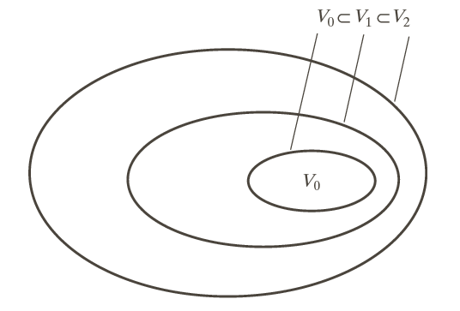
MRA
MRA Requirement
  [1] The scaling function is orthogonal to its integer translates.
  [2] The subspaces spanned by the scaling function at low scales are nested within those spanned at higher scales.
[1]

Slide 16
MRA
MRA Requirement
  [3] The only function that is common to all is .
  [4] Any function can be represented with arbitrary precision.

Slide 17
MRA
Refinement equation
  the expansion function of any subspace can be built from double-resolution copies of themselves.
Scaling vector/Scaling function coefficients

Slide 18
MRA
Wavelet function
  Fill up the gap of any two adjacent scaling subspaces
  Prototype
  Expansion functions
[1]

Slide 19
MRA
Wavelet function
  Scaling and wavelet vectors are related by
Wavelet vector/wavelet function coefficients

Slide 20
MRA
Wavelet series expansion

Slide 21
DWT
Discrete wavelet transforms(1D)
  Forward
  Inverse

Slide 22
DWT
Fast Wavelet Transforms
  Exploits a surprising but fortune relationship between the coefficients of the DWT at adjacent scales.
  Derivations for

Slide 23
DWT
Fast Wavelet Transforms
  Derivations for

Slide 24
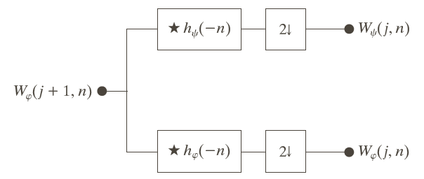
DWT
Fast Wavelet Transforms
  With a similar derivation for
  An FWT analysis filter bank
[1]

Slide 25
DWT
FWT
[1]

Slide 26
DWT
Inverse of FWT
  Applying subband coding theory to implement.
    acts like a low pass filter.
    acts like a high pass filter.
    ex. Haar wavelet and scaling vector
DFT
[1]

Slide 27
DWT
2D discrete wavelet transforms
  One separable scaling function
  Three separable directionally sensitive wavelets
y
x

Slide 28
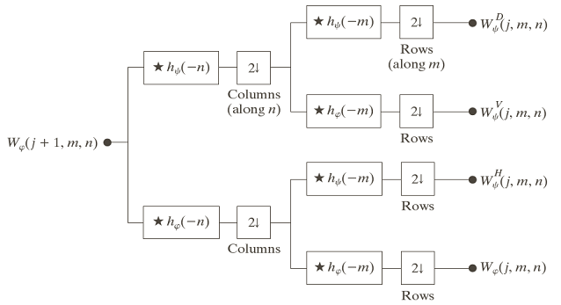
DWT
2D fast wavelet transforms
  Due to the separable properties, we can apply 1D FWT to do 2D DWTs.
[1]

Slide 29
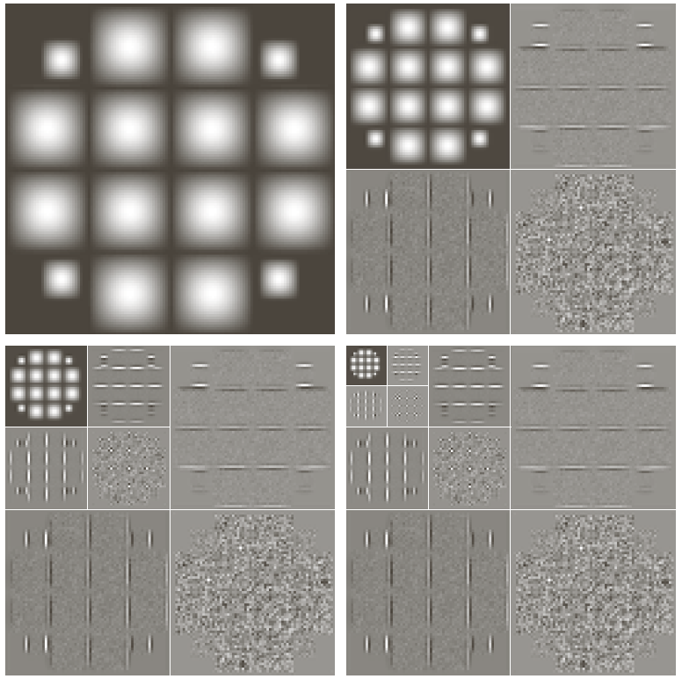
DWT
2D FWTs
  An example
LL
LH
HL
HH
[1]

Slide 30
DWT
2D FWTs
  Splitting frequency characteristic
[1]

Slide 31


Applications(1)
Image Compression
  have many near-zero coefficients
  JPEG : DCT-based
  JPEG2000 : FWT-based
[3]
DCT-based
FWT-based

Slide 32
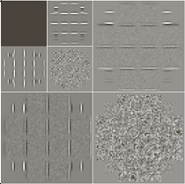
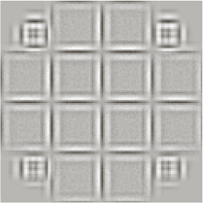

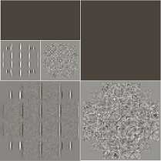
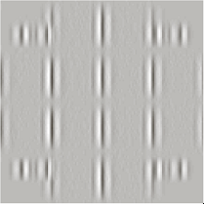
Applications(2)
Edge detection
[1]

Slide 33
Applicatiosn(3)
Digital watermarking
  Robustness
  Nonperceptible(Transparency)
  Nonremovable
Channel/Signal processing
Original and/or
Watermarked data
Watermark
Watermark
or
Confidence
measure
H
o
s
t
Digital watermarking
Watermark extracting
d
a
t
a
Secret/Public key
Secret/Public key

Slide 34
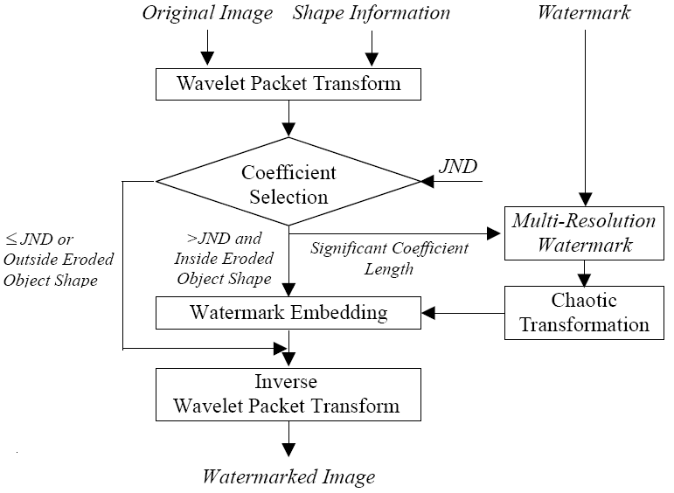
Applicatiosn(3)
Digital watermarking
  An embedding process

Slide 35
Conclusions&Future work
Wavelet transforms has been successfully applied to many applications.
Traditional 2D DWTs are only capable of detecting horizontal, vertical, or diagonal details.
Bandlet?, curvelet?, contourlet?

Slide 36
References
[1] R. C. Gonzalez, R. E. Woods, "Digital Image Processing third edition", Prentice Hall, 2008.
[2] J. J. Ding and N. C. Shen, “Sectioned Convolution for Discrete Wavelet Transform,” June, 2008.
[3] J. J. Ding and J. D. Huang, “The Discrete Wavelet Transform for Image Compression,”,2007.
[4] J. J. Ding and Y. S. Zhang, “Multiresolution Analysis for Image by Generalized 2-D Wavelets,” June, 2008.
[5] C. Valens, “A Really Friendly Guide to Wavelets,” available in http://pagesperso-orange.fr/polyvalens/clemens/wavelets/wavelets.html

